Slide 1
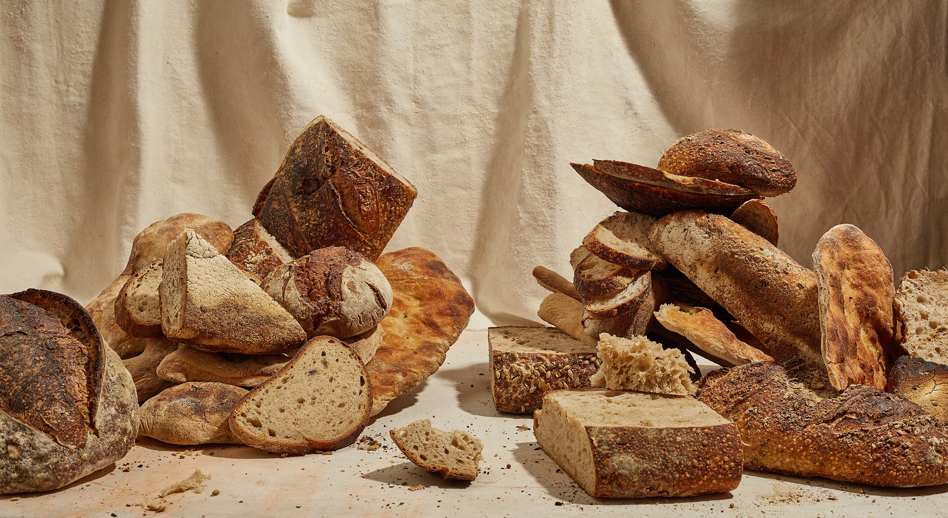
The two masters and the one not
BakeWise
Eliza Marija Kraule
Sarah Cherian
Ian Jiang
USER EVALUATION RESULTS

Slide 2
Participants
# of Participants: 3 users
Persona Mapping:
Perfectionist baker → user 1 - Lucie : Tested “Planning a Loaf” (backward scheduling & reminders) & “Fermentation Feedback” (technique validation & visual feedback)
Event Planner → user 2 - Kristine : Tested “Planning a Loaf” (backward scheduling & reminders) & “Fermentation Feedback” (technique validation & visual feedback)
Forgetful Baker → user 3 - Rafael : Tested “Reminders” (timing & notifications)
Notes:
Recruitment / Role Play: Users were asked to role-play as their assigned personas using real-life baking scenarios to simulate timing and feedback contexts.
We recruited three participants who represented our core personas from earlier research — the Perfectionist, the Event Planner, and the Forgetful Baker.
Lucie and Kristine tested the ‘Planning a Loaf’ and ‘Fermentation Feedback’ features, while our third participant - Rafael focused on the Reminder system.
Each user reflected the real behaviors and frustrations of our personas — struggling with timing, learning and building confidence in baking and consistency.”

Slide 3
Method
Location: In-person sessions on iPad working with prototype in Figma
Method: Think-aloud walk-through + short post-interview, observing & note taking
Tasks: Planning a Loaf, Fermentation Feedback, Reminders
Questions asked:
“What would you expect to happen next?”
“How easy or hard was that step?”
“If you were using this for a real bake, what would you do differently?”
“Was there anything confusing or missing?”
Notes:
We conducted in-person evaluations using iPads and printouts of the low-fidelity prototype. Participants were asked to think aloud as they performed three core tasks — planning a loaf, evaluating dough fermentation via feedback, and setting reminders.
We observed their navigation, hesitation points, and comments in real time, then followed up with a short interview to capture perceptions of strengths and weaknesses.
Some of the questions asked were -

Slide 4
Results
Strengths
Users liked the automatic scheduling feature to manage long baking processes.
Users found the notifications helpful - saw BakeWise as a baking assistant.
The fermentation checklist was seen as instructional and confidence-building, helping users understand the process step-by-step
Weaknesses
Some confusion about what the displayed time referred to (hands-on vs total time).
Fermentation feedback questions felt too subjective for beginners.
Reminder setup using “Remind me in [ ] hours” increased effort and confusion.
quotes:
“I love how it calculates backwards from when I want bread.”
“I’m not sure if this time is for me or the dough.”
“This checklist helps me feel like I’m doing it right, but i'm not sure how to answer the questions correctly.”
Notes:
Here’s what we found from our user sessions.
“In our user evaluation, participants really appreciated the overall concept of BakeWise. They especially trusted the automatic scheduling feature — it helped them plan baking steps around their day and prevented mistakes. Users also agreed that reminders are essential, since timing is the hardest part of baking. The fermentation checklist was another highlight — users described it as a ‘teaching tool’ that builds their confidence.
However, we also observed some friction. For example, participants weren’t always sure whether the displayed time represented their action time or the dough’s waiting time. Beginners also struggled with vague fermentation cues like ‘does it smell sour?’ And the ‘Remind me in [x] hours’ field required mental math — the opposite of what BakeWise aims to simplify.
These findings helped us identify the key usability problems we’ll address next.”

Slide 5
Problems
Issue U1: Scheduling Ambiguity & Label Confusion
Description: The time displayed on the interface is rigid, which may confuse users. The required operation time and waiting time are not marked on it, leaving users unaware of the time needed for the operation and the waiting period.
User Impact: Users are confused about whether the time shown refers to active hands-on time or total duration.
Issue U2: Fermentation Assessment Is Too Subjective
Description: The Yes/No judgments in the checklist (e.g., “Does it have a sour taste?”) are too vague, making it difficult for inexperienced users to accurately assess.
User Impact: The app fails to provide effective assistance, leaving users to “guess” the dough's condition.
Issue U3: Manual Reminder Input Format Is Inappropriate
Description: The input format “Remind me in [ ] hours” forces users to perform mental calculations, increasing cognitive load.
User Impact: Users require precise dates and times, not relative durations. This contradicts the app's design goal of reducing mental effort.
Notes:
“From those results, we synthesized three core usability problems. First, scheduling ambiguity — users couldn’t distinguish between active and resting times, which led to timing confusion. Second, fermentation feedback felt too subjective; beginners said they weren’t confident answering yes or no questions about dough readiness. Finally, reminder setup added unnecessary cognitive load because it required mental math instead of simply selecting when they wanted a notification.
These three issues guided the design ideas we’ll show next.”

Slide 6
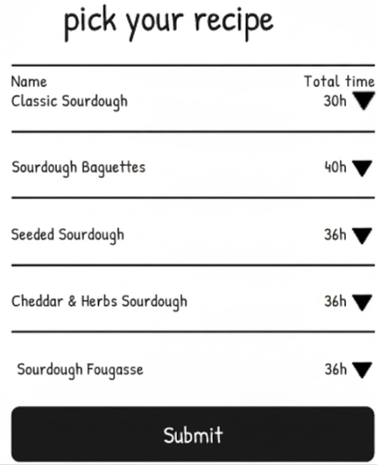
Design Idea #1: Scheduling Transparency - U1
Goal: Resolve user confusion about the duration.
Action: Keep the single displayed completion time (e.g., "Total Time ~30h) on the main recipe card.
Detail: Add a "View Details" pop-up or active time in parentheses next to the total time that clearly breaks down the schedule into:
Active Time (Hands-on time)
Waiting/Rest Time (Autolyse, Bulk Ferment, Cold Proof)
Total Duration (51 hours)
Notes:
We will maintain a clean completion time display on the main interface but add a pop-up window for viewing details. This pop-up will clearly show the operation time, waiting time, and total duration to eliminate user confusion.
As you can see, we envision adding an arrow next to the time to suggest users can click for more details.

Slide 7
Design Idea #2 - improve feedback checklist - U2
Add Visual Fermentation Comparison Guide
Replace vague Yes/No checklist items with visual examples of dough texture, bubbles, and elasticity.
Use side-by-side reference photos to show what “ready” looks like.
Adds objectivity and boosts learning for beginners.
Considering adding an LLM visual evaluation option (stretch goal)
Notes:
We will introduce visual references. On the assessment interface, we will provide annotated reference images or other format alongside a multi-point rating scale, enabling users to visually compare and accurately evaluate dough consistency.

Slide 8
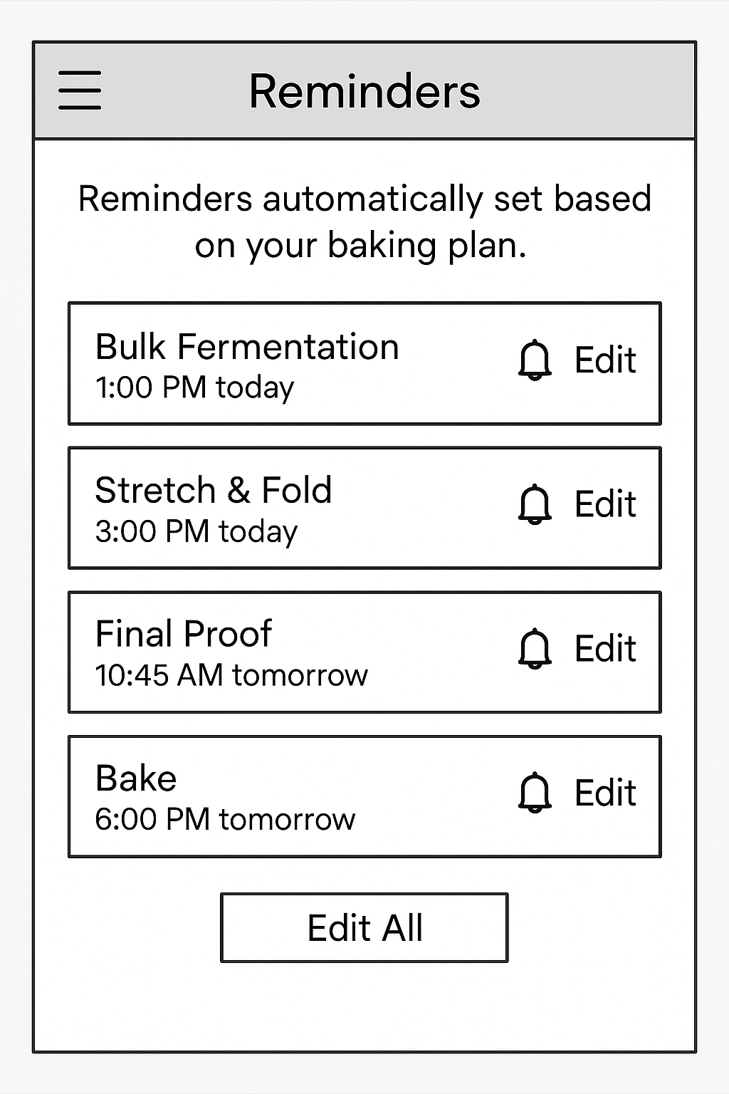
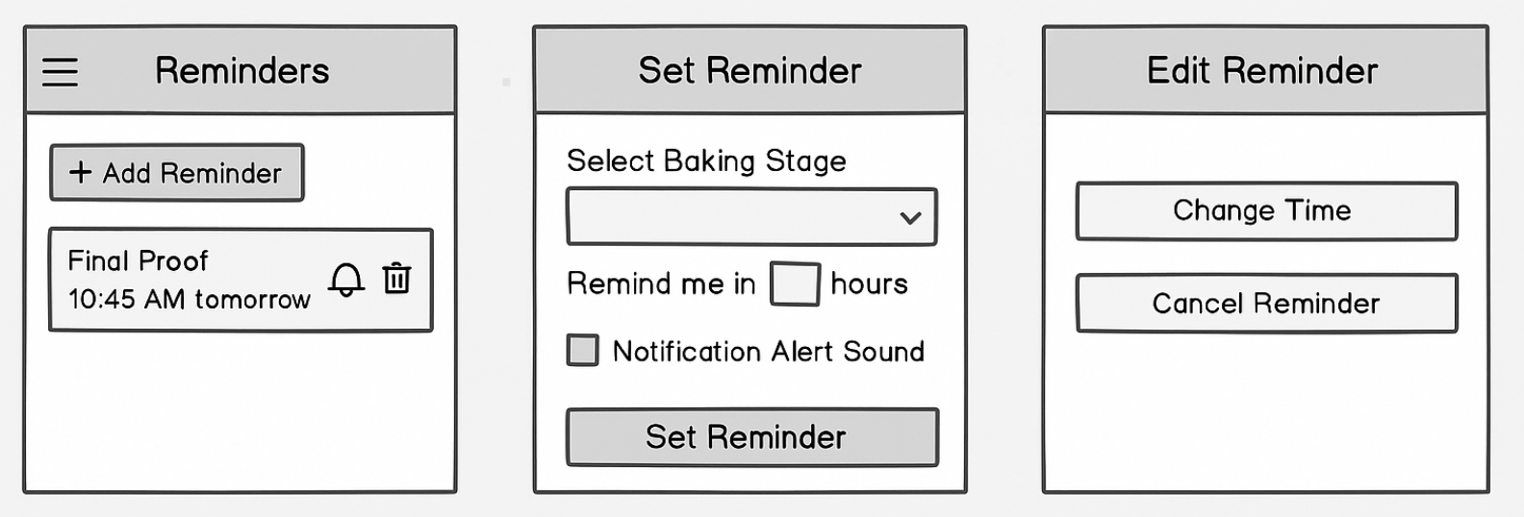
Design idea #3 Simplify Reminder Setup - U3
Goal: Reduce cognitive load for users setting future reminders by eliminating mental calculations
Replace text input (“in [x] hours”) with:
Pre-filled reminder options
Keep a custom option time/date picker for flexibility
Quick preset options (1h, 3h, 5h)
Notes:
D3 simplifies reminders by removing the need for mental math — users can just pick a preset or custom time, making the experience faster and more intuitive.
3rd design idea adddreses users issue 3 of reducing confusion around reminder set up
“We realized reminders should not require manual entry. In the next iteration, BakeWise we will use auto-generated pre filled reminders based on the user’s goal time and baking stages. Users can still adjust or disable them but won’t need to calculate or input times themselves. This would reinforce BakeWise’s role as an active baking assistant rather than a passive timer and simplify the mental oad

Slide 9
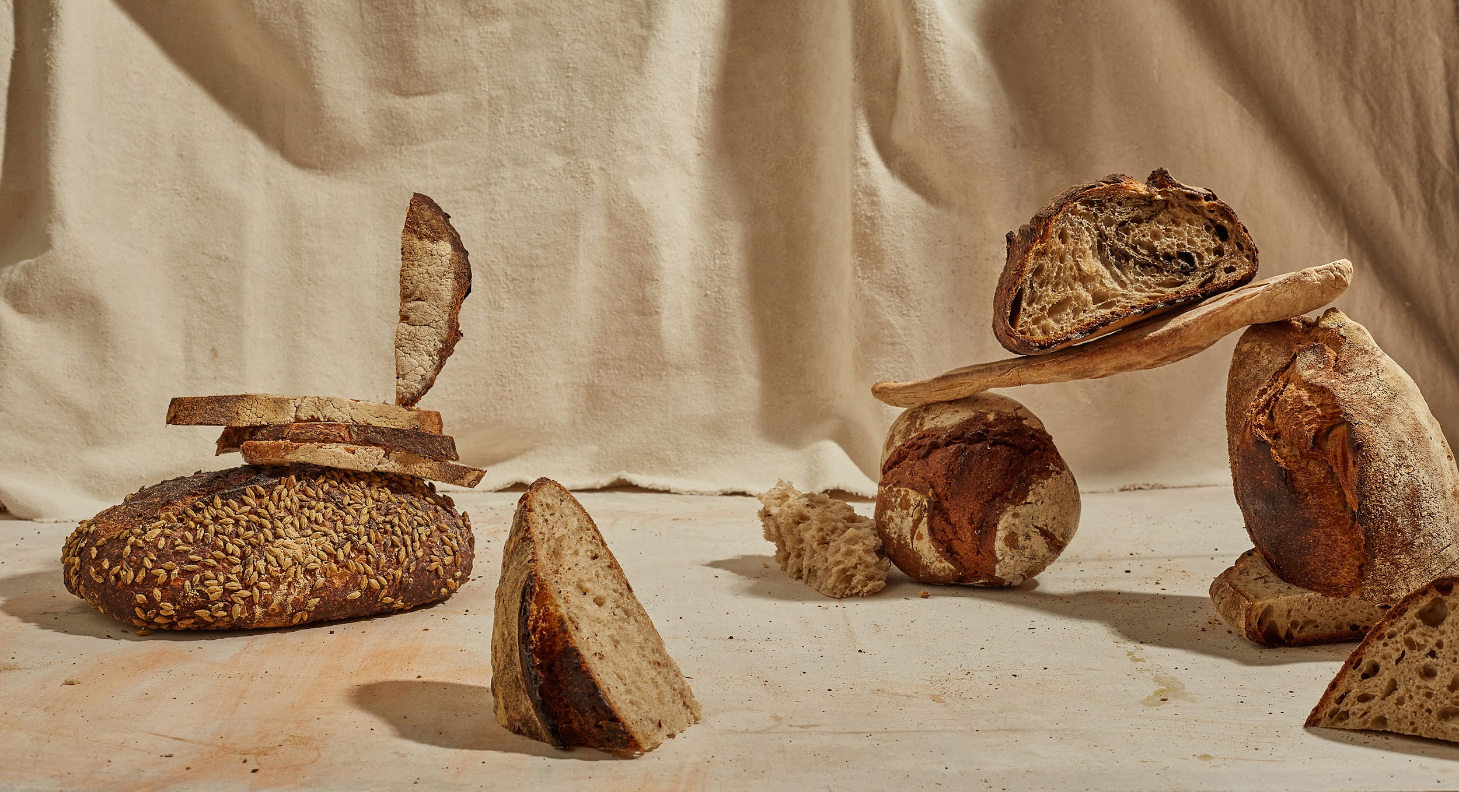
Thank you!

